Slide 1
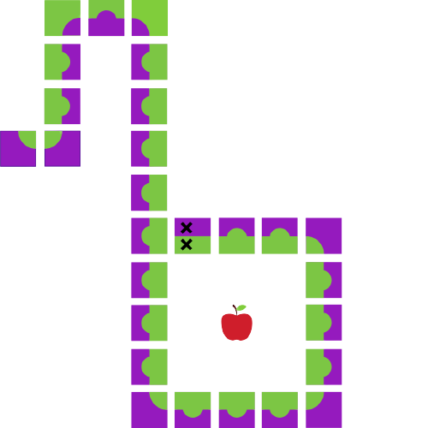
Java Workshop 6
Aadila Ali Sabry

Slide 2
Methods
Loops are good when we want to repeat an action several times consecutively
But what if I want to repeat a series of actions, but not necessarily several times at once?
AKA “Functions”

Slide 3
Method Declaration Syntax
Parameters go in round brackets
public static return_type function_name (type param1, … , typeN paramN) { }
The “static” keyword will be compulsory for as long as you are not doing object oriented programming
You must have the type of each parameter beside its name
Parameters are separated by commas, not semicolons!
Your code goes in the curly braces
The “public” keyword allows all other parts of your program to use your method. Other possible values are “private” and “protected”.
Unless you set the return type to void, you must have a return statement of the form return data;

Slide 4
Calling Methods
scanner.nextInt (); //returns int
string.contains (string); //returns boolean
Math.pow (2, 5); //returns int
System.out.println (“Hello!\n”); //returns nothing

Slide 5
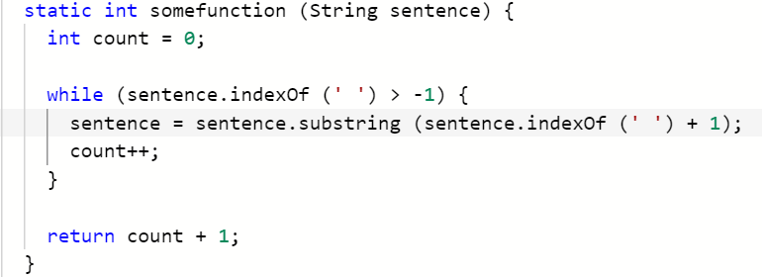
Notes:
CountWords - Replit

Slide 6
Multipurposing Average
Notes:
Average 2 - Replit

Slide 7
Combining Programs
Notes:
Combining Code using Methods - Replit

Slide 8
Overloading
What if I want to define the same function, but for different data types?
For example:
string.indexOf (int ch);
string.indexOf (String str);
string.indexOf (String str, int fromIndex);

Slide 9
Sums
Notes:
Overloading - Replit

Slide 10
Scope
static int global;
public static void someFunction () {
int x;
//……………………………………………….
}
//……………………………………………………….
Public static void main (String args []) {
int y;
//………………………………………………..
}
Notes:
Global Variable - Replit

Slide 11
Recursion
Functions can call themselves
Careful! This can go wrong very fast
Remember: you need a base case

Slide 12
Break Time

Slide 13
Triangle Numbers
Notes:
Triangle Numbers - Replit

Slide 14
Factorial
Notes:
Factorial - Replit

Slide 15
Tower of Hanoi
Notes:
Tower of Hanoi - Replit

Slide 16
Errors in Java
Three types of errors:
Compile-time
Run-time
Logic
Java runtime errors are called exceptions

Slide 17
Exception Handling
try {
//code that can cause an error
} catch (Exception exceptionName) {
//code in case something goes wrong
} finally {
//code that will always be executed
}

Slide 18
Maxing with try-catch
Notes:
Try-catch - Replit

Slide 19
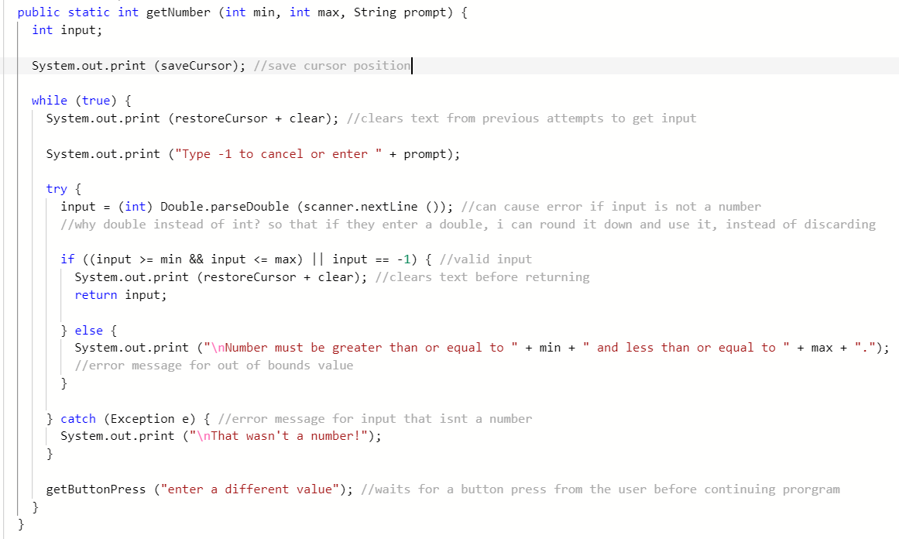

Slide 20
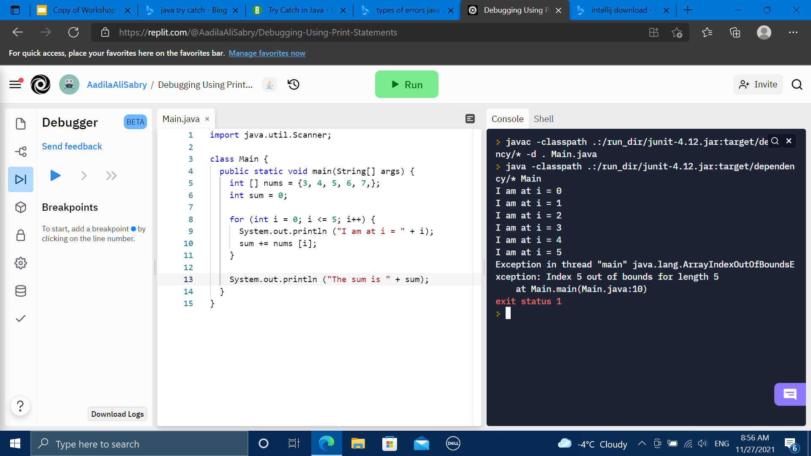
Debugging with Print Statements

Slide 21
Debugging with IntelliJ
Notes:
Logic errors

Slide 22
Questions!
Notes:
Can also go over the problems we didn’t get to from previous classes

